Slide 1

Introduction to Operating Systems CS 1550
Spring 2022
Sherif Khattab
ksm73@pitt.edu
(Some slides are from Silberschatz, Galvin and Gagne ©2013)

Slide 2
Course Goal and Objectives
Continue to demystify a good portion of the magic about how computers work so that you can write more efficient programs
The specific objectives are:
Modify and compile the Linux kernel to add system calls
Write multi-process/multi-thread programs free from race conditions and deadlocks
Simulate page-replacement algorithms for virtual memory management
Implement a user-land file system

Slide 3
Contact Info
Course website: http://www.cs.pitt.edu/~skhattab/cs1550/
Instructor: Sherif Khattab ksm73@pitt.edu
OH: https://khattab.youcanbook.me
TuTh: 16:30-19:30 (remote until Jan 26 then in-person/remote)
F: 16:00-18:00 (remote only for the entire term)
6307 Sennott Square, Virtual Office: https://pitt.zoom.us/my/khattab
Teaching Team:
TBD
Recitations start this week!
Communication
End of week newsletter
Piazza (Please expect a response within 72 hours)
Email not recommended!

Slide 4
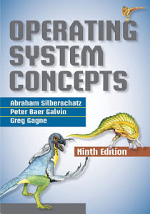
Textbook
Operating System Concepts (9th Edition)
Silberschatz, Galvin, and Gagne

Slide 5
Grading
40% on 4 projects
System programming using C
Posted on Canvas and submitted on Gradescope (auto-graded)
20% on two exams: 12% on higher and 8% on lower
18% on weekly homework assignments
14% recitation: 5 labs using MIT’s Xv6 operating system and 4 quizzes on the projects
8% in-class Tophat questions and discussions

Slide 6
Canvas Walkthrough
Lectures posted on Tophat by end of each lecture day
Lecture and recitation recordings under Panopto Video
Pre- and Post-course test
Piazza for discussion
Gradescope and autograding policies
Homework attempts
Academic Integrity
NameCoach

Slide 7
Expectations
Your continuous feedback is important!
Anonymous Qualtrics survey
Midterm and Final OMET
Your engagement is valued and encouraged.

Slide 8
Lecture structure (mostly)
Time | Description
~5 min before and after class | Informal chat
~25 min | Announcements, review of reflections, and QA on projects/labs/homework problems
~40 min | Lecturing
~5 min | Tophat questions and/or activities
~5 minutes | QA and muddiest points/reflections

Slide 9
Why is this class (notoriously) hard?
Lots of concepts
Attend lectures and recitations (if you absolutely cannot attend live, watch the video recordings)
Study often!
Put effort into the weekly homework assignments
Projects are relatively hard
Refresh your C programming and GDB debugging skills (CS 0449!)
Start early and show up to office hours!

Slide 10
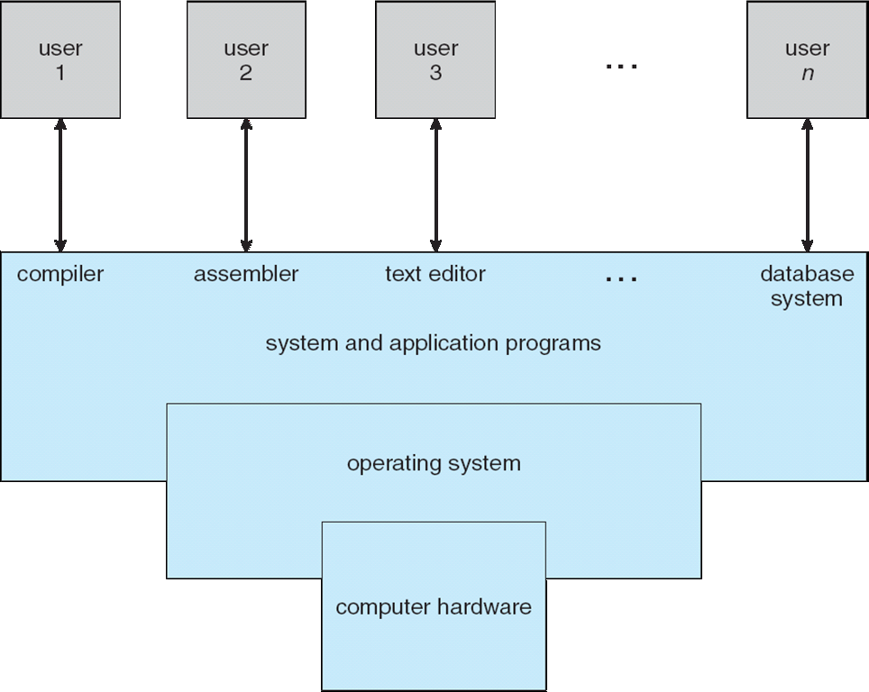
What is an Operating System?
A program that acts as an intermediary between a user of a computer and the computer hardware

Slide 11
What does an OS do?
Manages (controls and arbitrates) resources
Processors, Memory, Input/output devices, Communication devices, Storage, Software applications
Conflicting goals:
Performance vs. utilization
Provides abstractions to application programs
Ease of use
Virtualization
Protects resources

Slide 12
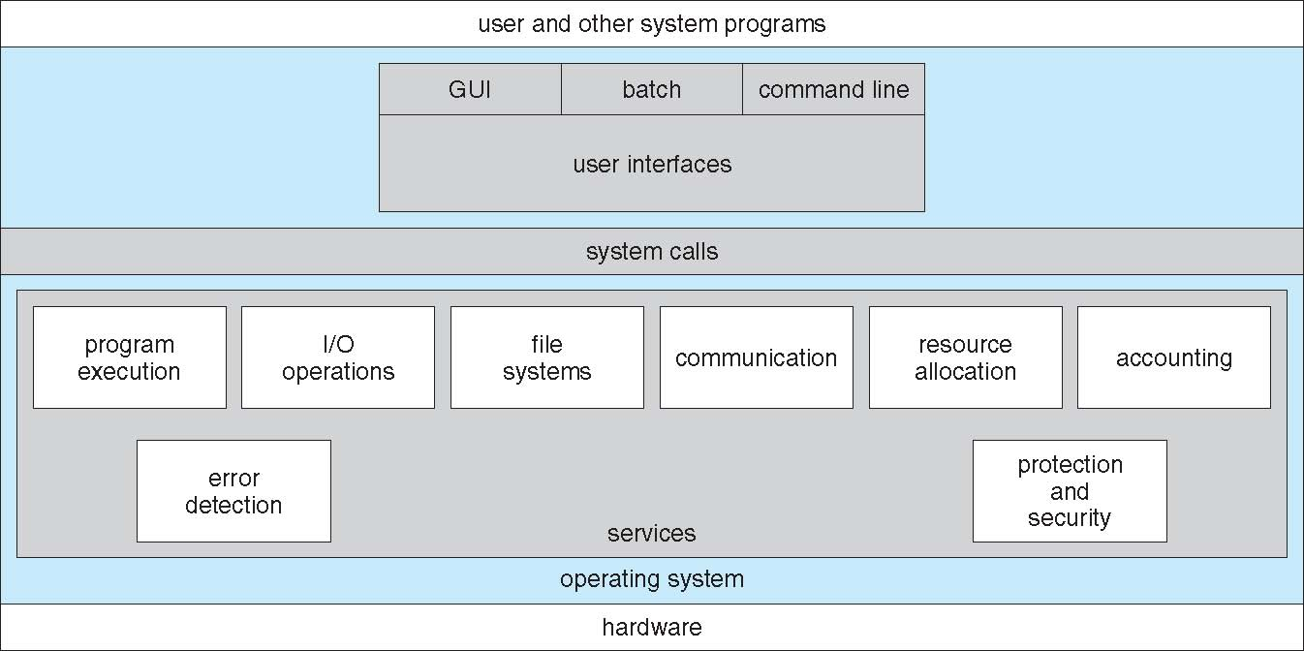
A View of Operating System Services

Slide 13
How does an OS work?
Two main enabling mechanisms:
Interrupts
Dual-mode operation of the CPU
Kernel mode and user mode

Slide 14
Interrupts
Interrupt transfers control to the interrupt service routine (ISR)
ISRs are segments of code that determine what action should be taken for each type of interrupt
The interrupt vector contains the addresses of all the service routines
Hardware or software:
Hardware interrupt by one of the devices
Software interrupt (exception or trap):
Request for operating system service
Software error (e.g., division by zero)
Other process problems include processes trying to modify each other’s or the operating system’s memory

Slide 15
Dual-mode Operation
Dual-mode operation allows OS to protect itself and other system components
User mode and kernel mode
Mode bit provided by hardware
Provides ability to distinguish when system is running user code or kernel code
Some instructions designated as privileged, only executable in kernel mode
System call changes mode to kernel, return from call resets it to user
Increasingly CPUs support multi-mode operations
virtual machine manager (VMM) mode for guest VMs

Slide 16
How does an OS (roughly) work?

